Slide 1
Multi-Language in SW360
Presenter: Le Tien
Team Leader, Toshiba Software Development (Vietnam) Co., Ltd.
SW360 Workshop
Dec 19th 2019

Slide 2

Agenda
View of SW360
Multi-Language solution
Demonstration

Slide 3
View of SW360
SW360 is an OSS tool used for centrally managing software component information, license information, vulnerability information.
Internationalization: why is so important?
Organizations can use SW360 as a one-stop shop for sharing component information, tracking their usage in projects or products.
Currently, SW360 supports only the English language.
Toshiba has begun centralizing information management of open source software by SW360. This made it possible to share open source information across departmental barriers.

Slide 4
Multi-Language solution
SW360 is a Liferay portal application.
One of the best features of Liferay is its ability to support multiple language.
Currently Liferay provide support for 50 languages out of the box.
Multi-language system of SW360 will be based on Liferay

Slide 5
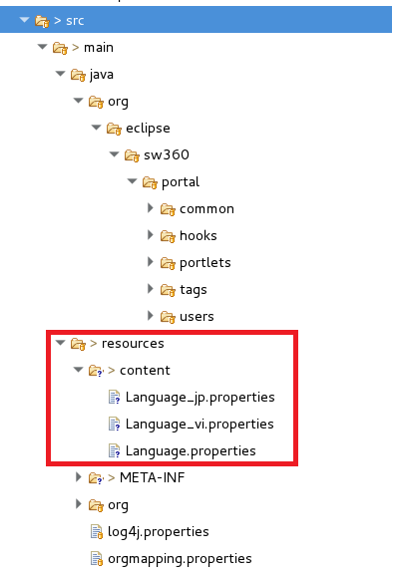
Multi-Language solution
SW360 src
Provide Language*.properties files

Slide 6
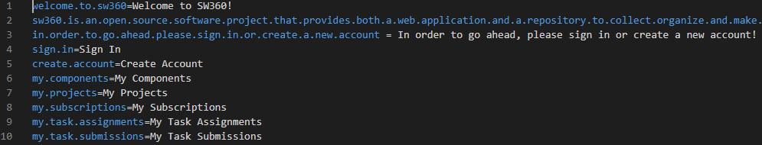
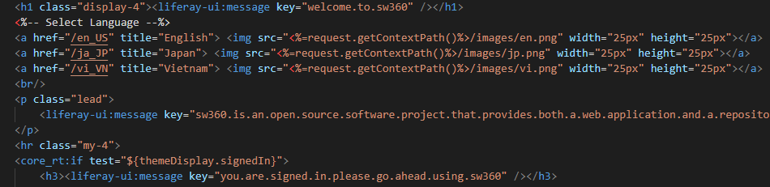
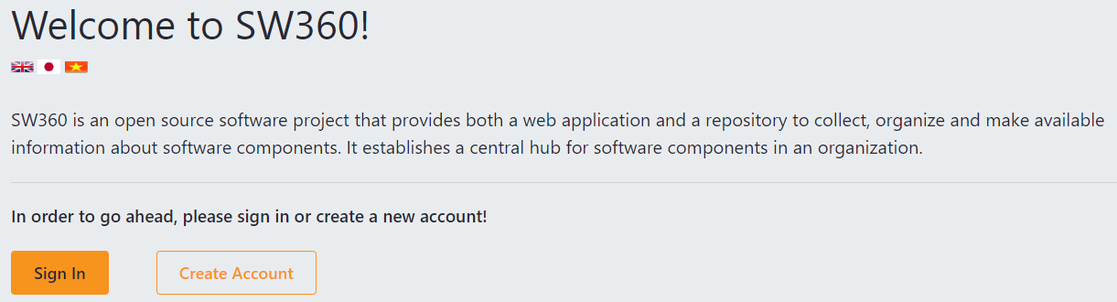
Multi-Language solution

Slide 7
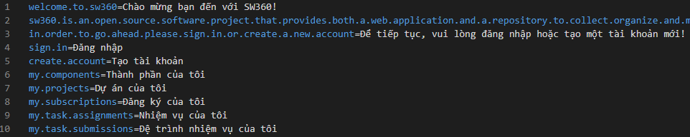
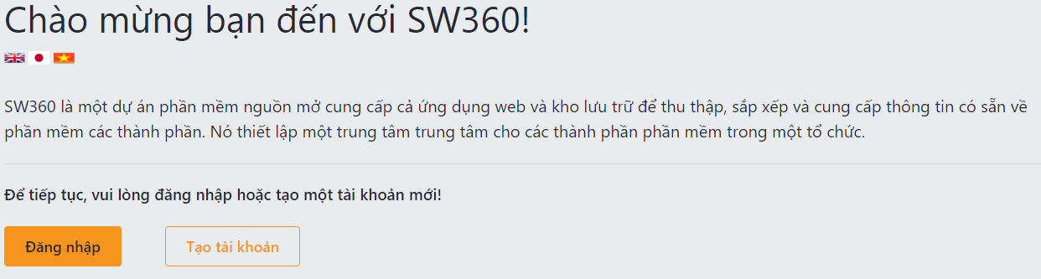
Multi-Language solution

Slide 8
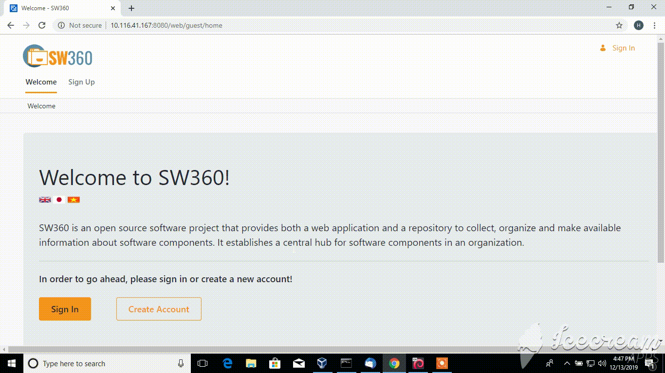
Demonstration

Slide 9
Contact
Email
tien.le@toshiba-tsdv.com
Slack
https://sw360chat.slack.com
https://openchain-japanwg.slack.com
Notes:
Dot, at, hyphen

Slide 10


